Slide 1
Scientometric Mapping of Interpreting Evolution of topics, authors and collaboration’s over time and space
Chandan Uppuluri
Nisha Chadwani
Shruthi Ramakrishnan
Vinay Kumar Ranganath Babu

Slide 2
Goal
Create visualizations that give insights about domain of interpreting, evolution of topics, authors, collaborations and citations across time (when) and space (where: geo-spatial)

Slide 3
Related Work
In Xu and Pekelis_Chinese Interpreting Studies A Data Driven Analysis_Peerj 2015 paper discusses mainly about citation analysis in the field of interpreting .
Doors and Gambier Measuring relationships in Translation Studies Perspectives 2015 , in this study the main focus is on the geographical spread of the Translation and Interpreting Research using academic Affiliations. This paper explains about what research has been done till date.

Slide 4
Dataset
The required data for this project is obtained from the Scopus database.
2931 records of data.
Steps involved in obtaining the dataset:
Conducting the following search in Scopus: (TITLE ( “interpreter” ) OR TITLE ( "interpreting studies" ) OR TITLE ( "conference interpret*" ) OR TITLE ( "court interpret*" ) OR TITLE ( "medical interpret*" ) OR TITLE ( "sign language interpret*" ) OR TITLE ( "community interpret*" ) OR TITLE ( "simultaneous interpret*" ) OR TITLE ( "consecutive interpret*" ) ) OR (ABS ( "interpreting studies" ) OR ABS ( "conference interpret*" ) OR ABS ( "court interpret*" ) OR ABS ( "medical interpret*" ) OR ABS ( "sign language interpret*" ) OR ABS ( "community interpret*" ) OR ABS ( "simultaneous interpret*" ) OR ABS ( "consecutive interpret*" ) ) AND ( DOCTYPE ( ar ) OR DOCTYPE ( ip ) OR DOCTYPE ( bk ) OR DOCTYPE ( ch ) OR DOCTYPE ( cp ) )
Cleaning records which seemed to be erroneous.
Extracting the 1990-2016 records

Slide 5
Fields present in Dataset
Author
Title
Year
Cited by
Affiliations
Authors with affiliations
Abstract
Author Keywords
References

Slide 6
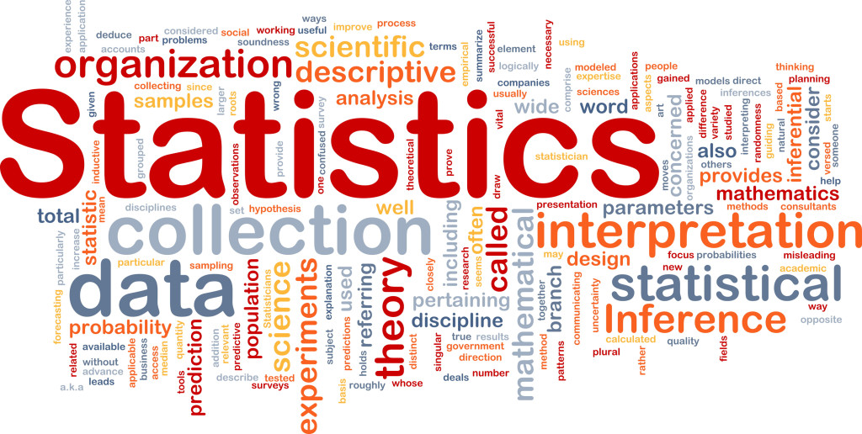
Data Visualization
Topic Analysis – Word Cloud: The goal is to create a chart in the form of a world cloud. We will overlay topics data.

Slide 7
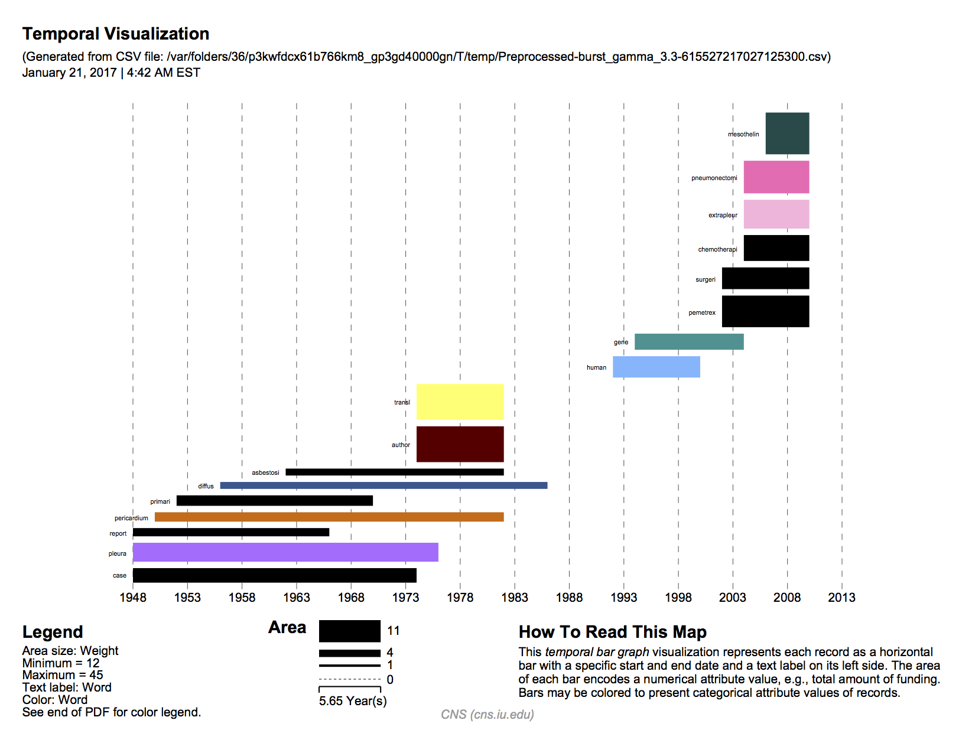
Topic Analysis: Burst of terms across time: In this visualization, we can see the burst of topics in the domain of interpreting across time.

Slide 8
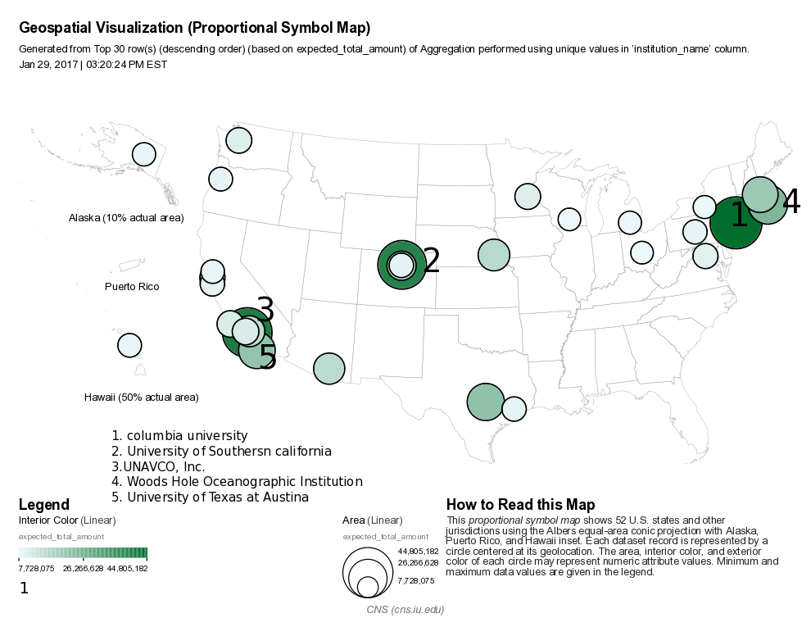
Geospatial Location of Lead Authors: We will be using proportional symbol map to overlay the data of number of authors that have contributed towards the domain of interpreting.

Slide 9
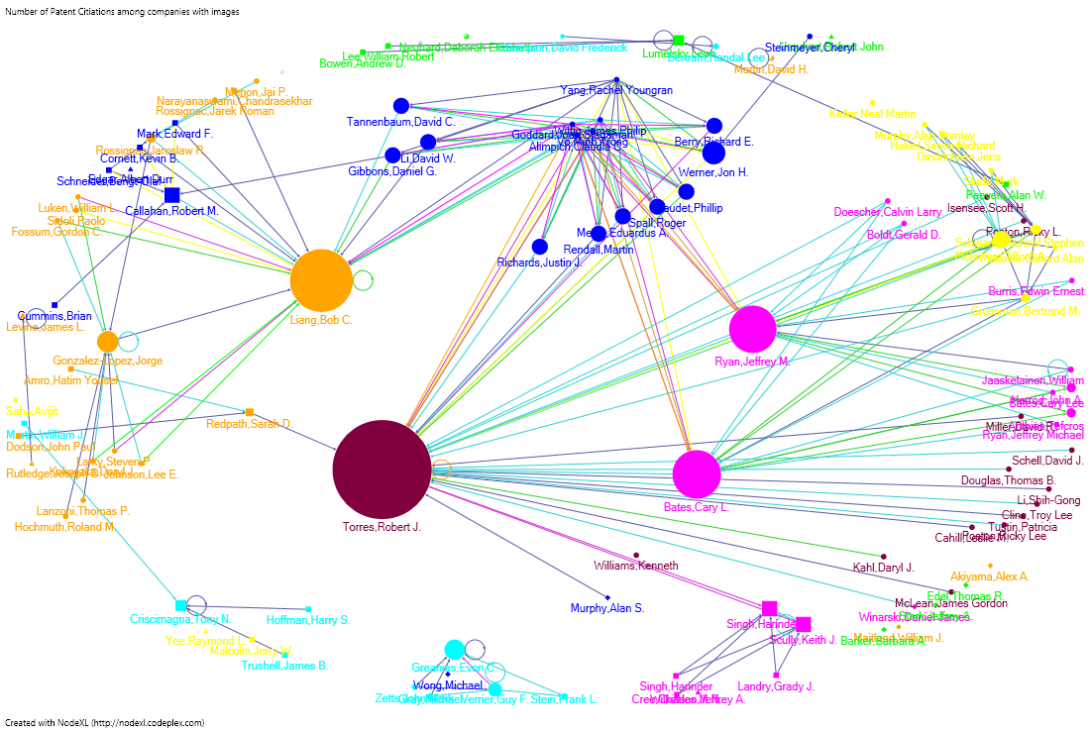
Paper Citation Network: The reference system that will be used here is a network graph that shows the citations network of the authors. This depends on the dataset that we have and how much information it holds as the dataset is still tentative and not yet finalized.

Slide 10
Interactive Visualization
Using Shiny Web app with plotly/ D3
Various levels of interactions can be as follows:
Time Toggle affect: With this we can select the time / year to see how the topics/authors have evolved during the particular time frame.
Filters: Using filters we should be able to sub select authors, Countries, Topics etc
Data Overlay: Based on the time/Filters used the appropriate data must be overlaid.

Slide 11
Challenges and Opportunities
The major challenge is to obtain a clean data set as there is a lot of possible noise. But by refining query terms in Scopus database we can obtain a better dataset.
Another challenge is to implement an interactive visualization’s. Using appropriate tools such as shiny web app/plotly/D3 etc should help us build interactive visualizations easily.

Slide 12
Acknowledgements:
Lluís Baixauli-Olmos, Assist. Prof., Dept. of Classical and Modern Languages at the university of Louisville has helped with us in understanding the scope of the project and any other queries that we had. We have worked with LLuis closely to obtain the necessary dataset from the Scopus database.

Slide 13
References:
Interpretation or Interpreting wikipedia : https://en.wikipedia.org/wiki/Language_interpretation
World Cloud example image: http://www.jsquaredanalytics.com/word-clouds/
Citation Network wiki: https://wiki.cs.umd.edu/cmsc734_11/index.php?title=File:Citation_IBm.png
Sci2 Team. (2009). Science of Science (Sci2) Tool. Indiana University and SciTech Strategies, http://sci2.cns.iu.edu.
In Xu and Pekelis_Chinese Interpreting Studies A Data Driven Analysis_Peerj 2015
Doors and Gambier_Measuring relationships in Translation Studies_Perspectives 2015.

Slide 14
THANK YOU

